Slide 1
Online Claims Entry Adjustment, Void and Re-bill
Conduent
Government Healthcare Solutions

Slide 2
Adjustments Overview
Paid claims which need to be updated must be adjusted. If submitted as a separate claim, it will deny as a duplicate.
Denied claims do not need to be adjusted, they should be resubmitted as new claims.
If a claim has been adjusted previously, the last adjustment in the series must be adjusted.
Claims entered through the web portal (Online Claims Entry) can be adjusted on the web portal or on paper. Claims processed through EDI or on paper CAN NOT be adjusted on the web portal.
When entering changes to the claim online, attach any new documents pertinent to the updated claim.

Slide 3
Adjustments – Filing Limit
The timely filing limit for adjustments is 90 days from the remittance date for the paid claim.
If a paid claim is adjusted after the 90 day timely filing limit, it may deny for timely filing and recoup the original paid amount.
Please verify that an adjustment is within the timely filing limit of the original payment date before submitting online.
If an adjustment is needed after the 90 day limit, please submit the adjustment on paper. Timely filing will be overridden if the payment is the same or less than the original payment.

Slide 4
Submitting an Adjustment
Conduent
Government Healthcare Solutions

Slide 5
Adjustments
Open Claims Entry and click on Adjustment/Void to open the Adjustment window.

Slide 6
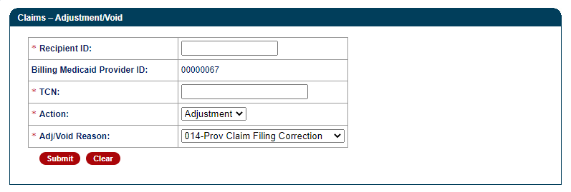
Adjustments
Enter the client Medicaid ID in the Recipient ID field. Enter the TCN of the original claim. Select Adjustment in the Action menu and select 014 in the Adj/Void Reason menu.

Slide 7
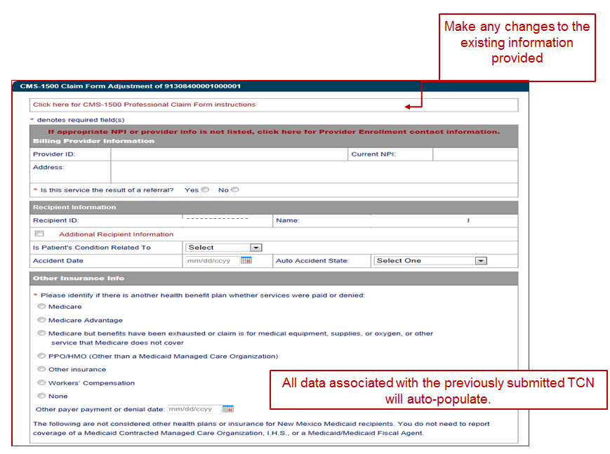
CMS- 1500 Adjustment Form

Slide 8
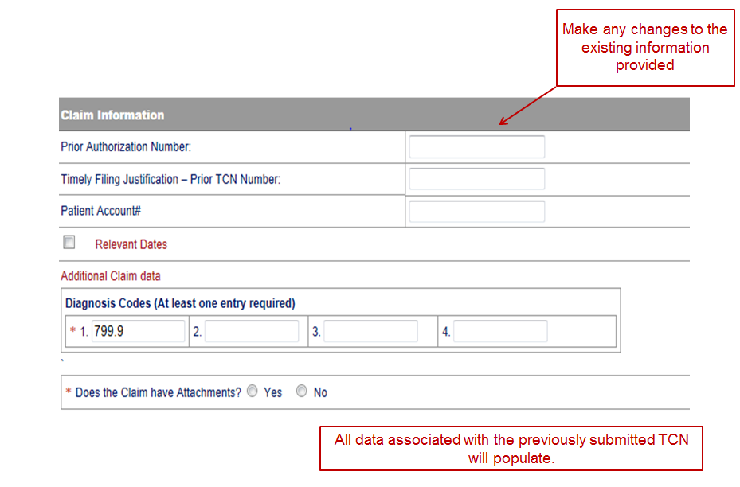
CMS- 1500 Adjustment Form

Slide 9
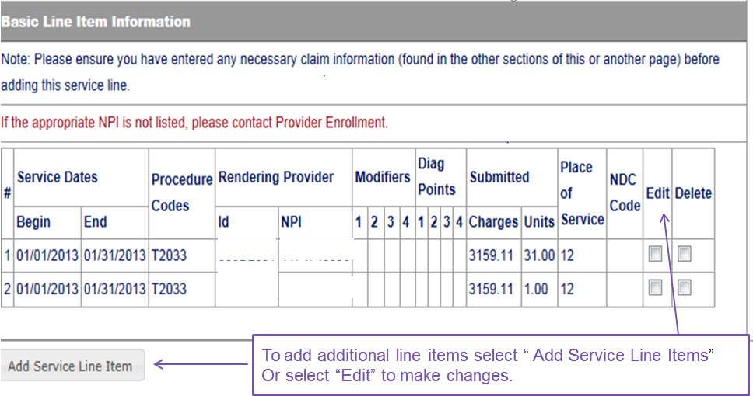
CMS- 1500 Adjustment Form
All data associated with the previously submitted TCN will auto-populate
Make any changes to the existing information provided
Notes:
continued

Slide 10
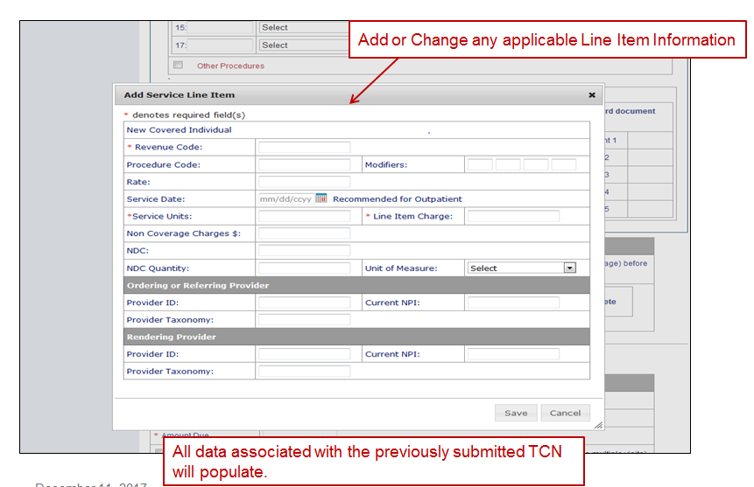
CMS- 1500 Adjustment Form

Slide 11
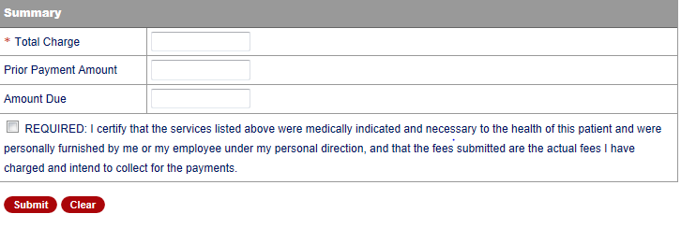
CMS- 1500 Adjustment Form
Update the Total Charge, Prior Payment, and Amount Due if needed.
Click the certify button and Submit to receive the adjustment TCN and status.

Slide 12
UB-04 Adjustments
Conduent
Government Healthcare Solutions

Slide 13
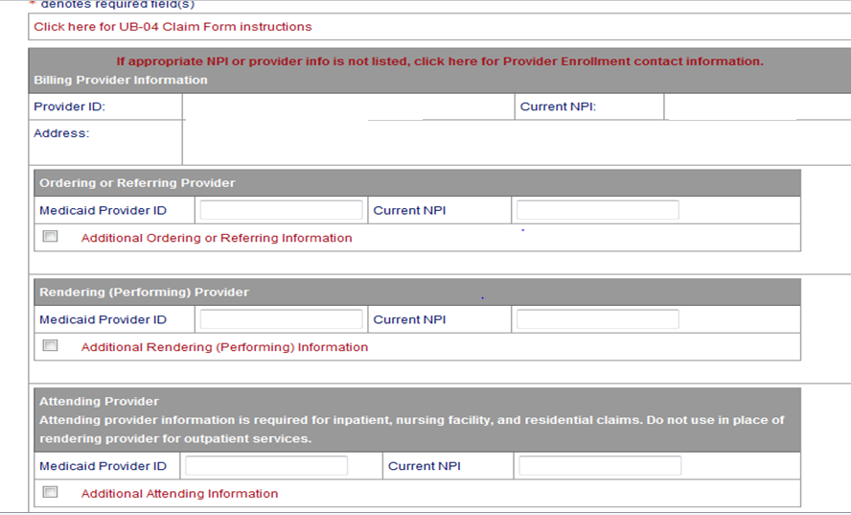
UB-04 Adjustments
Make any changes to the existing information provided
All data associated with the previously submitted TCN will auto-populate

Slide 14
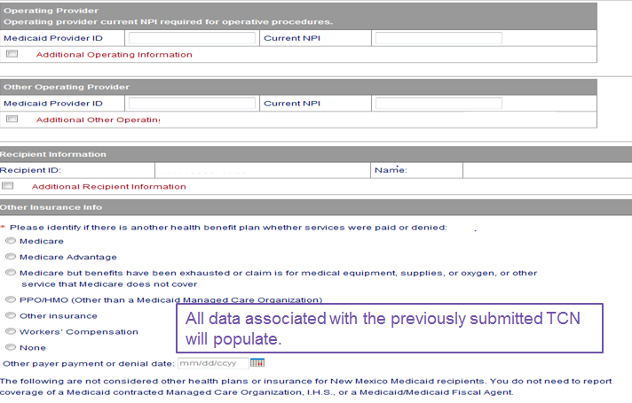
UB-04 Adjustments
Make any changes to the existing information provided
All data associated with the previously submitted TCN will auto-populate
Notes:
continued

Slide 15
UB-04 Adjustments
All data associated with the previously submitted TCN will auto-populate
Make any changes to the existing information provided
Notes:
continued

Slide 16
UB-04 Adjustments
All data associated with the previously submitted TCN will auto-populate
Make any changes to the existing information provided
Notes:
continued

Slide 17
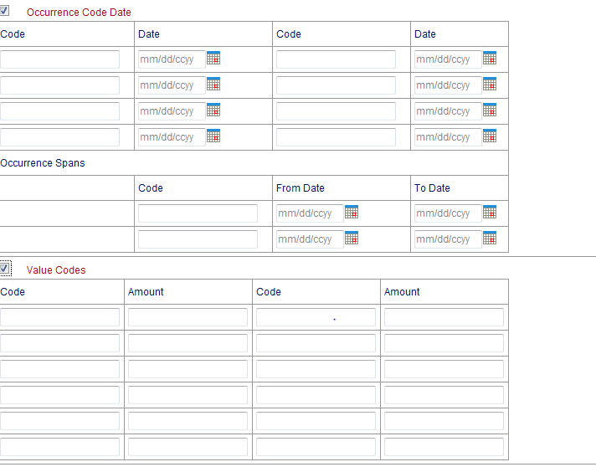
UB-04 Adjustments
All data associated with the previously submitted TCN will auto-populate
Make any changes to the existing information provided
Notes:
continued

Slide 18
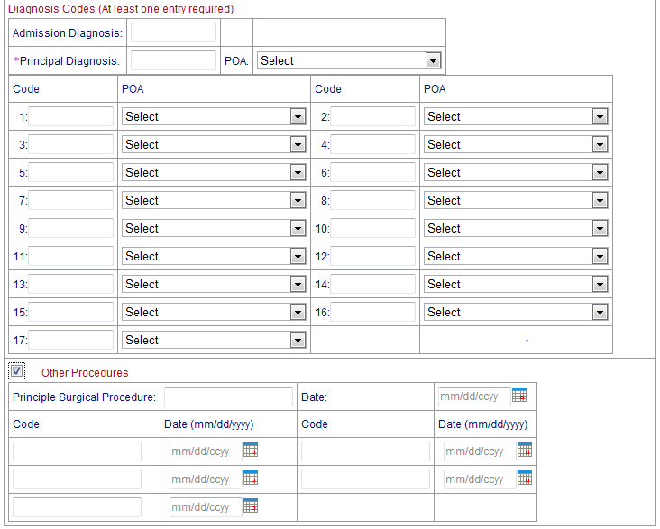
UB-04 Adjustments
All data associated with the previously submitted TCN will auto-populate
Make any changes to the existing information provided
Notes:
continued

Slide 19
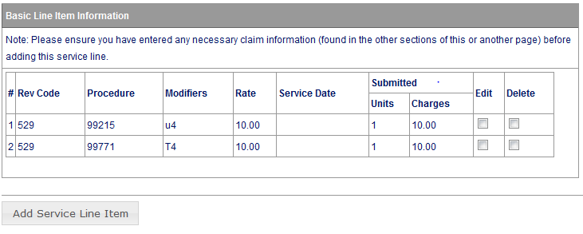
UB-04 Adjustments
All data associated with the previously submitted TCN will auto-populate
Make any changes to the existing information provided
To add additional line items, select “Add Service Line Items” Select “Edit” to make changes to lines already populated.
Notes:
continued

Slide 20
UB-04 Adjustments
All data associated with the previously submitted TCN will auto-populate
Make any changes to the existing information provided
Notes:
continued

Slide 21
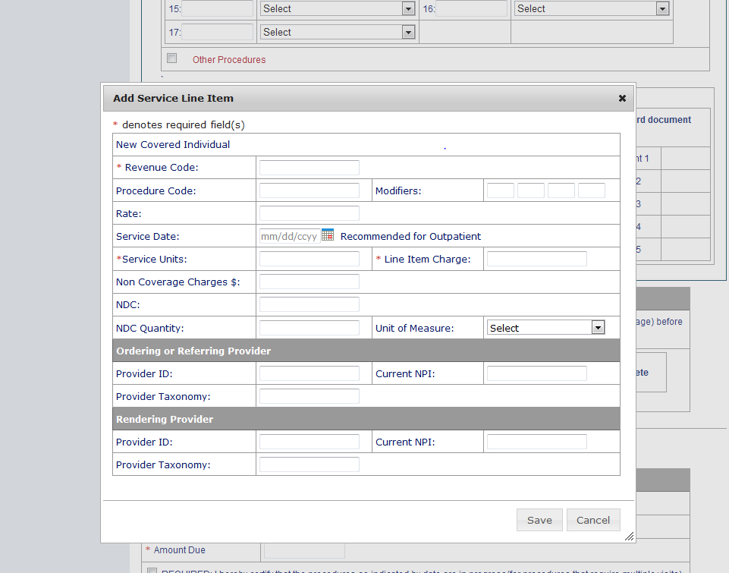
UB-04 Adjustments
All data associated with the previously submitted TCN will auto-populate
Make any changes to the existing information provided
Notes:
continued

Slide 22
UB-04 Adjustments
Update the Total Charge, Prior Payment, and Amount Due if needed.
Click the certify button and Submit to receive the adjustment TCN and status.

Slide 23
Submitting a Void
Conduent
Government Healthcare Solutions

Slide 24
Void Overview
Voids should be submitted for paid claims which need to be fully recouped.
The entire claim will be voided. If only individual lines need to be recouped, the claim should be adjusted.
Denied claims can not and do not need to be voided.
Claims entered through the web portal (Online Claims Entry) can be voided on the web portal or on paper. Claims processed through EDI or on paper CAN NOT be voided on the web portal.
There is no timely filing limit for voiding claims.

Slide 25
Void Request
Open Claims Entry and click on Adjustment/Void to open the Void window.

Slide 26
Void Request
Enter the client Medicaid ID in the Recipient ID field. Enter the TCN of the original claim. Select Void in the Action menu and select 081 in the Adj/Void Reason menu.

Slide 27
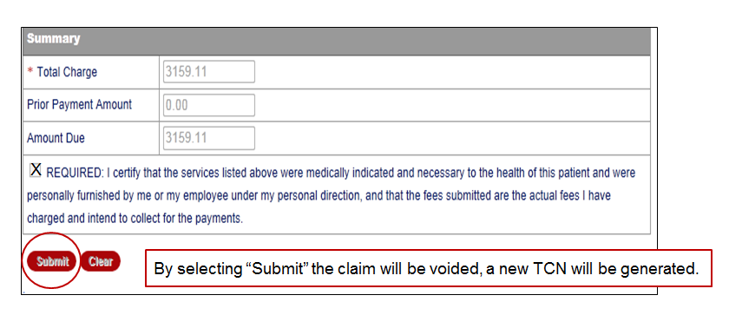
Void Request
Click the certify button and Submit to receive the void TCN.

Slide 28
Claims Re-bill
Conduent
Government Healthcare Solutions

Slide 29
Claims Re-bill Overview
The purpose of Claim Re-billing is to allow a previously denied claim to be corrected without requiring the entire claim to be entered again.
Only denied claims should be re-billed. If a paid claim is re-billed, the new claim will deny as a duplicate.
The timely filing period is the same for rebilled claims as for any resubmitted claim.

Slide 30
Claims Re-bill
Click on Claim Re-Bill to open the Rebill window. Enter the client Medicaid ID and TCN of the denied claim and submit to open the claim for correction.

Slide 31
What Questions Do You Have?

Slide 32
New Mexico Medicaid Resources
New Mexico Medicaid Online
Provider Information
Provider Login Screen Notices
Provider E-News Newsletters
Medicaid Provider Relations Call Center
Provider Communication Updates
Provider Field Representative
Provider Webinars
Open Forums and Live Training Sessions
Continued on next page . . .

Slide 33
New Mexico Medicaid Resources Continued
New Mexico Medicaid Portal – https://nmmedicaid.portal.conduent.com/static/index.htm
Claim Inquiries, Eligibility Verification, Electronic Claim Submission, Provider Manuals, E-News
NM Health Care Authority – http://www.hca.nm.gov
Supplements, Memos, Provider Billing Packets and Policy
Medical Assistance Division – PE Program Staff – HSD.PEDeterminers@state.nm.us
Assistance with PE Applications, PE Determinations, MAD 070, PE Training, PE Certification
Consolidated Customer Service Call Center – (800) 299 - 7304
Claim Status, Eligibility, Prior Authorization, Medicaid Updates
Conduent Provider Relations Helpdesk – NMProviderSUPPORT@conduent.com
Claim research assistance and general Medicaid inquiries
Conduent HIPAA Helpdesk – HIPAA.DeskNM@hsd.nm.gov Assistance on NM Web Portal, EDI inquiries, and Online Claim Submission with DDE (Direct Data Entry)
Conduent Provider Enrollment Helpdesk - NMProviderSUPPORT@conduent.com
Provider Enrollment Applications, Forms & Instructions
Medical Assistance Division, Program Rules – http://www.hca.nm.gov/providers/rules-nm-administrative-code/
NMAC for Programs administered by the Medical Assistance Division Yes New Mexico - https://www.yes.state.nm.us/yesnm/home/index Apply, check, update, or renew Medical Assistance (Medicaid) benefits

